Slide 1

The Sprint

Slide 2
Understand what Sprint Backlog is
The Doing List
How to use the DoD (definition of Done) to move a feature from Doing to Done
Done List
Objectives

Slide 3
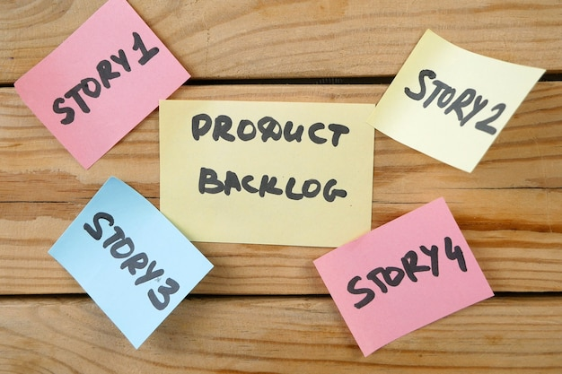
Sprint backlog
Sprint Backlog
Is the list that contains the product features that the development team have committed complete in this Sprint. All the features are at the DoR state.

Slide 4
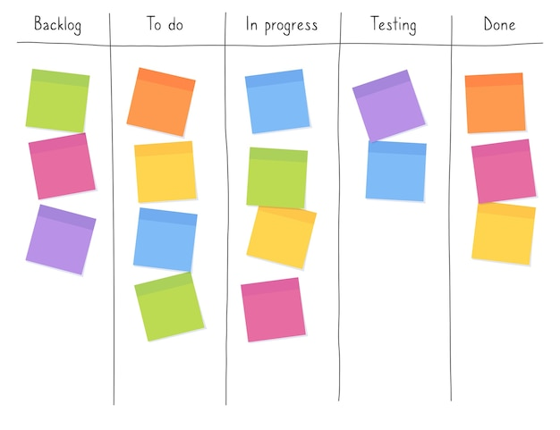
Doing List
When a developer begins work on an item in the Sprint Backlog list that item is moved from the Sprint Backlog to the Doing list.
Doing list

Slide 5


Daily Standup Ceremony
This is a daily 15-minute meeting held first thing in the morning. To keep conversation quick and on point, attendants must stand up during the meeting.
This is used to optimise communication across the team.
Daily Stand up

Slide 6
Matters discussed in Daily standup meetings
Progress on User Stories:
Discuss completed tasks, work in progress, and any impediments.
Yesterday's Achievements:
Any completed tasks, resolved issues, or any other significant achievements.
Today's Plan:
Mention tasks to complete and any new work.
Impediments and Obstacles:
Identify any impediments or obstacles. The team to collaborate and escalate issues.

Slide 7
Matters discussed in Daily standup meetings
Collaboration Opportunities:
Discuss opportunities for collaboration or assistance.
Dependencies:
Discuss any dependencies between tasks or team members.
Adjustments to Sprint Backlog:
The team may make adjustments such as set priorities or add new tasks.
Availability and Capacity:
Communicate your availability and capacity for the day.

Slide 8
Matters discussed in Daily standup meetings
Technical Insights:
Share any technical insights or discoveries with the team.
Testing Updates:
Mention any test cases completed, ongoing testing, or issues discovered.
Continuous Integration and Deployment:
Discuss updates related to continuous integration and deployment.
Celebrate Successes:
Celebrate successes and the other team member’s contributions.
Reflection on Agile Principles:
Reflect on how well the team is adhering to Agile principles.

Slide 9
During the meeting, the following points are discussed by every participant:
What did I do yesterday that helped meet the sprint goal?
What will I do today to help meet the sprint goal?
Do I see any future impediments that prevents the team from meeting the sprint goal?
Daily Stand Up

Slide 10
Once a developer has completed work on the product feature in the Doing list and that feature meets the requirement of DoD, then the feature is moved from the Doing List to the Done List.
Done list
A checklist of items which could be included for a feature could include for DoD is:-
Unit testing written and passed
Documentation updated
Peer code review completed

Slide 11
How do we know something meets the definition of Done (DOD)?
The work (PBI) is developed tested
Meet all the acceptance criteria
Is deployed on the test server for further tests Is a potentially Shippable software.
DoD is determined by the Scrum Team
Checklist
Code commented, checked in and in the current version in source control
Peer reviewed
Meets the company's development standards
Unit tested and all the tests have passed
Deployed to system test environment and has passed all the system tests
Passed UAT (user Acceptance Tests)
Has all the relevant documentation and all the docs are updated
Remaining hours is zero and task closed and shown in the burndown chart
More on DOD

Slide 12

You Understand
Review
What Sprint Backlog is
When to move features to the Doing List
How to use the DoD (definition of Done) to move a feature from Doing to Done
What the Done List is

Slide 13


Lab
Complete Lab9
Duration 90 minutes

